Slide 1
Computer Organization and Assembly Language
Lecture 7 – 8

Slide 2
Outline
Operand Types
Direct Memory Operands
Data Transfer instructions
INC and DEC Instructions
ADD Instruction
SUB Instruction
NEG Instruction
FLAGS affected by Addition and Subtraction

Slide 3
Book Chapters
“Assembly Language for x86 processors”
Author “Kip R. Irvine”
6th Edition
Chapter 4
Section 4.1
Section 4.2

Slide 4
Operand Types (1/2)
We know the format of an instruction from previous lectures
[label:] mnemonic [operand] [;comment]
Instructions can have 0 – 3 operands
Operands can be any of
Register: Name of an x86 register
Memory: Reference to a memory location
Immediate value: a numeric literal

Slide 5
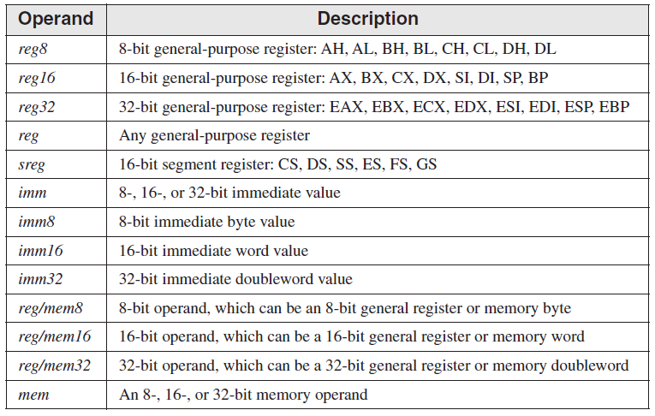
Operand Types (2/2)

Slide 6
Direct Memory Operand
Name of a variable shows its offset in data segment
.data
var DB 10h
.code
mov al, var
If var is stored at address 00000001h, when assembled, above code produces following machine instruction
A0 00000001

Slide 7
MOV Instruction (1/2)
Copies data from a source operand to a destination operand
First operand is the destination and second operand is the source
MOV dest, src

Slide 8
MOV Instruction (2/2)
Some rules to follow when using MOV
Both operands must have same size
Both operands cannot be memory operands
CS, EIP, IP cannot be destination operands
An immediate value cannot be moved to a segment register
Some useful variants of MOV
MOV reg, reg
MOV reg, mem
MOV reg, imm
MOV mem, reg
MOV mem, imm

Slide 9
Zero/Sign Extension of Integers (1/4)
MOV cannot copy data directly from a smaller operand to a larger one
Suppose we want to move a byte variable var into a 16-bit register ax
.data
var DB 10h
.code
MOV ax, 0
MOV al, var

Slide 10
Zero/Sign Extension of Integers (2/4)
What happens if same approach is followed to copy a negative number?
What is the value in ax after this code is assembled?
What happened to -8?
.data
svar DB -8
.code
MOV ax, 0
MOV al, svar
0 | 0 | 0 | 0 | 0 | 0 | 0 | 0 | 1 | 1 | 1 | 1 | 1 | 0 | 0 | 0
248

Slide 11
Zero/Sign Extension of Integers (3/4)
How about doing like this?
.data
svar DB -8
.code
MOV ax, 0FFFFh
MOV al, svar
1 | 1 | 1 | 1 | 1 | 1 | 1 | 1 | 1 | 1 | 1 | 1 | 1 | 0 | 0 | 0
-8

Slide 12
Zero/Sign Extension of Integers (4/4)
These examples show different approaches for signed and unsigned number
In case of unsigned numbers, a zero is extended to all higher order bits of the destination operand
In case of signed numbers, the sign-bit is extended to all higher order bits of the destination operand

Slide 13
MOVZX Instruction (1/2)
MOVZX (MOVe with Zero-eXtend) copies the source operand into destination operand and extends zeroes in the remaining higher order bits of destination operand
It has three variants
MOVZX reg32, reg/mem8
MOVZX reg32, reg/mem16
MOVZX reg16, reg/mem8

Slide 14
MOVZX Instruction (2/2)
.data
val DB 11000011b
.code
MOVZX ax, val
0
1 | 1 | 0 | 0 | 0 | 0 | 1 | 1
0 | 0 | 0 | 0 | 0 | 0 | 0 | 0 | 1 | 1 | 0 | 0 | 0 | 0 | 1 | 1

Slide 15
MOVSX Instruction (1/2)
MOVSX (MOVe with Sign-eXtend) copies the source operand into destination operand and extends the sign-bit in remaining higher order bits in destination operand
It has three formats
MOVSX reg32, reg/mem8
MOVSX reg32, reg/mem16
MOVSX reg16, reg/mem8

Slide 16
MOVSX Instruction (2/2)
.data
val DB 11000011b
.code
MOVSX ax, val
1 | 1 | 0 | 0 | 0 | 0 | 1 | 1
1 | 1 | 1 | 1 | 1 | 1 | 1 | 1 | 1 | 1 | 0 | 0 | 0 | 0 | 1 | 1
.data
val DB 01000011b
.code
MOVSX ax, val
0 | 1 | 0 | 0 | 0 | 0 | 1 | 1
0 | 0 | 0 | 0 | 0 | 0 | 0 | 0 | 0 | 1 | 0 | 0 | 0 | 0 | 1 | 1

Slide 17
Practice Problem 1
Determine the status of EAX after every instruction
.data
oneByte DB 78h
oneWord DW 1234h
oneDword DD 12345678h
.code
mov eax,0
mov al,oneByte
mov ax,oneWord
mov eax,oneDword
mov ax,0
; EAX = 00000000h
; EAX = 00000078h
; EAX = 00001234h
; EAX = 12345678h
; EAX = 12340000h

Slide 18
XCHG Instruction (1/2)
XCHG instruction exchanges the contents of two operands
This instruction has three different variants
XCHG reg, reg
XCHG reg, mem
XCHG mem, reg
The rules for operands in the XCHG instruction are the same as those for the MOV instruction, except that XCHG does not accept immediate operands

Slide 19
XCHG Instruction (2/2)
Here are some examples to use XCHG instruction
xchg ax,bx ; exchange 16-bit regs
xchg ah,al ; exchange 8-bit regs
xchg var1,bx ; exchange 16-bit mem op with BX
xchg eax,ebx ; exchange 32-bit regs
To exchange two memory operands, a register is used as temporary container
mov ax,val1
xchg ax,val2
mov val1,ax

Slide 20
Direct-Offset Operands (1/2)
Adding a displacement or offset to the name of a variable
This technique makes it possible to access memory locations which do not have explicit labels
For example, to access individual elements of an array

Slide 21
Direct-Offset Operands (2/2)
.data
arr DB 1, 2, 3, 4, 5
.code
MOV al, arr ; mov 1 in al
MOV ah, arr+1 ; mov 2 in ah
.data
arr DW 1, 2, 3, 4, 5
.code
MOV ax, arr ; mov 1 in ax
MOV ax, arr+2 ; mov 2 in ax

Slide 22
Practice Problem 2
Determine the status of registers after the execution of each instruction
.code
mov bx,0A69Bh
movzx eax,bx
; EAX = 0000A69Bh
movzx edx,bl
; EDX = 0000009Bh
movzx cx,bl
; CX = 009Bh

Slide 23
Practice Problem 3
Determine the status of registers after the execution of each instruction
.code
mov bx,0A69Bh
movsx eax,bx
; EAX = FFFFA69Bh
movsx edx,bl
; EDX = FFFFFF9Bh
mov bl,7Bh
movsx cx,bl
; CX = 007Bh

Slide 24
Practice Problem 4
Determine the status of registers after the execution of each instruction
.data
val1 DW 1000h
val2 DW 2000h
.code
mov ax,val1
; AX = 1000h
xchg ax,val2
; AX=2000h, val2=1000h
mov val1,ax
; val1 = 2000h

Slide 25
Practice Problem 5
Determine the status of registers after the execution of each instruction
.data
arrayB DB 10h,20h,30h,40h,50h
.code
mov al,arrayB
; AL = 10h
mov al,[arrayB+1]
; AL = 20h
mov al,[arrayB+2]
; AL = 30h

Slide 26
Practice Problem 6
Determine the status of registers after the execution of each instruction
.data
arrayD DD 10000h,20000h
.code
mov eax,arrayD
; EAX = 10000h
mov eax,[arrayD+4]
; EAX = 20000h
mov eax,[arrayD+4]
; EAX = 20000h

Slide 27
INC and DEC Instructions (1/2)
INC instruction increments 1 in a single operand
DEC instruction decrements 1 from a single operand
Syntax is
INC reg/mem
DEC reg/mem
Flags affected
OF, SF, ZF, AF, PF

Slide 28
INC and DEC Instructions (2/2)
.data
a DB 10h
.code
INC a
MOV al, a
DEC al
; a = 11h
; al = 10h

Slide 29
ADD Instruction
Adds a source operand into a destination operand
Both operands must have the same size
Sum is stored in the destination operand
Syntax is
ADD dest, src
Flags affected
CF, ZF, SF, OF, AF, PF

Slide 30
SUB Instruction
Subtracts a source operand from a destination operand
Both operands must have the same size
Result is stored in the destination operand
Syntax is
SUB dest, src
Flags affected
CF, ZF, SF, OF, AF, PF

Slide 31
NEG Instruction
Reverses the sign of a number by taking its 2’s complement
Syntax is
NEG reg
NEG mem
Flags affected
CF, ZF, SF, OF, AF, PF

Slide 32
Flags Affected by Addition and Subtraction
Status flags reflect the outcome of an arithmetic or logic instruction
based on the contents of destination operand
Essential flags are
ZF
set when destination operand equals zero
SF
set when destination operand is negative
CF
set when unsigned value is out of range
OF
set when signed value is out of range
MOV instruction never affects the flags

Slide 33
Zero Flag (ZF)
ZF is set when the result of an operation produces zero in the destination operand
Remember that
A flag is set when it equals 1
A flag is clear when it equals 0
MOV al, 1
SUB al, 1
MOV bl, 0FFh
INC bl
INC bl
;no flag affected
;al=0 → ZF=1
;no flag affected
;bl=0 → ZF=1
;bl=1 → ZF=0

Slide 34
Sign Flag (SF)
SF is set when destination operand is –ve
SF is clear when destination is +ve
MOV al, 0
SUB al, 1
ADD al, 2
;no flag affected
;al=-1 → SF=1
;al=1 → SF=0

Slide 35
Carry Flag (CF)
CF is set when result of an arithmetic operation generates an unsigned value that cannot fit into destination operand
MOV al, 0FFh
ADD al, 1
MOV al, 0
SUB al, 1
;no flag affected
;al=00h → CF=1
;no flag affected
;al=0FFh → CF=0

Slide 36
Overflow Flag (OF) (1/2)
OF is set when the result of a signed arithmetic operation overflows or underflows the destination operand
MOV al, +127
ADD al, 1
MOV al, -128
SUB al, 1
;no flag affected
;al=?? → OF=1
;no flag affected
;al=?? → OF=1

Slide 37
Overflow Flag (OF) (2/2)
When adding two integers, remember that OF is only set when
Two positive operands are added and their sum is negative
Two negative operands are added and their sum is positive
Overflow never occurs when the signs of two addition operands are different.

